Slide 1




GRADE 10 · ALGEBRA II · TOPIC 2
Lesson 2-3
Factored Form of a
Quadratic Function
Journey of 6 stations, 60 minutes
Quadratic Functions and Equations
Mr Malek Thiab
FAITH, RIGHTEOUSNESS AND WISDOM
Notes:
Speaker notes: Welcome to Lesson 2-3: Factored Form of a Quadratic Function.
Timing: 60 minutes (Diagnose 6, Targeted Instruction 18, Practice 12, Production 12, Mastery Gate 6, Smart Production 6). For a 40-minute class scale every station by two thirds.
The journey map on the next slide shows the six stations; in slideshow mode the Morph transition zooms the station circles into the breadcrumb at the top of every later slide.

Slide 2


Today's journey
Six stations. Each one zooms in as we arrive.
Targeted Instruction
18 min
Production
12 min
Smart Production
6 min
2
4
6
1
3
5
Diagnose
6 min
Practice
12 min
Mastery Gate
6 min
FAITH, RIGHTEOUSNESS AND WISDOM
Notes:
Speaker notes: This is the whole map. Walk it left to right: Diagnose (what we already know), Targeted Instruction (Factored form shows the zeros; Solve by factoring; Positive and negative intervals), Practice (Practice, Apply, Investigate), Production (the Red Sea dive-tour profit), Mastery Gate (three questions to pass), Smart Production (create, then Time to Check).
In slideshow mode the Morph transition animates these circles shrinking into the breadcrumb on later slides; without Morph the slides fade.
Ask the class which station they think will be hardest.

Slide 3
What we are learning
OBJECTIVES
VOCABULARY
Solve quadratic equations by factoring.
Find the zeros of a quadratic function by factoring.
Determine the intervals where a quadratic function is positive or negative.
factored form
negative interval
positive interval
x-intercepts
zeros (of a quadratic function)
zero-product property
HSA.SSE.A.1.B · HSA.SSE.B.3.A · HSA.APR.B.3 · HSF.IF.C.7 · HSF.IF.C.7.A · HSA.SSE.A.2 · HSF.IF.C.8.A
FAITH, RIGHTEOUSNESS AND WISDOM
Mr Malek Thiab · 3
Notes:
Speaker notes: Read the objectives aloud one at a time and have students say which one they feel least sure about.
Vocabulary used today: factored form, negative interval, positive interval, x-intercepts, zeros (of a quadratic function), zero-product property.
Standards are on the next slide.
The essential question and mathematical practices are not shown because they are not in the project documents; add them from the curriculum map if you want them displayed.

Slide 4
Standards
HSA.SSE.A.1.B Interpret complicated expressions by viewing one or more of their parts as a single entity.
HSA.SSE.B.3.A Factor a quadratic expression to reveal the zeros of the function it defines.
HSA.APR.B.3 Identify zeros of polynomials when suitable factorizations are available, and use the zeros to construct a rough graph of the function defined by the polynomial.
HSF.IF.C.7 Graph functions expressed symbolically and show key features of the graph, by hand in simple cases and using technology for more complicated cases.
HSF.IF.C.7.A Graph linear and quadratic functions and show intercepts, maxima, and minima.
HSA.SSE.A.2 Use the structure of an expression to identify ways to rewrite it. For example, see x4 - y4 as (x2)2 - (y2)2, thus recognizing it as a difference of squares that can be factored as (x2 - y2)(x2 + y2).
HSF.IF.C.8.A Use the process of factoring and completing the square in a quadratic function to show zeros, extreme values, and symmetry of the graph, and interpret these in terms of a context.
HSA.SSE.A.1.B · HSA.SSE.B.3.A · HSA.APR.B.3 · HSF.IF.C.7 · HSF.IF.C.7.A · HSA.SSE.A.2 · HSF.IF.C.8.A
FAITH, RIGHTEOUSNESS AND WISDOM
Mr Malek Thiab · 4
Notes:
Speaker notes: Standards are quoted verbatim from the curriculum map. Students do not need to read them aloud; point to the ones that match today's objectives.

Slide 5
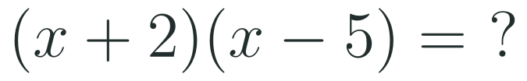

1
2
3
4
5
6
STATION 1 · DIAGNOSE · 6 MIN
Start here: three quick checks
1
2
3
Done when
All three are answered without a calculator, and you can say why a product equal to 0 forces one of its factors to be 0.
HSA.SSE.A.1.B · HSA.SSE.B.3.A · HSA.APR.B.3 · HSF.IF.C.7 · HSF.IF.C.7.A · HSA.SSE.A.2 · HSF.IF.C.8.A
FAITH, RIGHTEOUSNESS AND WISDOM
Mr Malek Thiab · 5
Notes:
Speaker notes (Diagnose, 6 min, no calculator):
Answers. Q1: (x+2)(x-5) = x^2 -5x +2x -10 = x^2 - 3x - 10. Q2: two numbers with product 6 and sum 5 are 2 and 3, so (x+2)(x+3). Q3: a = 0 or b = 0. Verbal misconceptions: Q1 students write x^2 - 10 (they forget the middle terms) or x^2 + 3x - 10 (sign slip on the middle term); Q2 students pick 1 and 6 (product right, sum wrong); Q3 students answer 'both are 0' - say 'at least one'. Adaptive routing: if >30% miss Q1, spend 2 minutes on expanding two brackets with an area model, then go to slide 6 / block 1; if >30% miss Q2, pause on slide 7 / block 2 and rehearse the product-and-sum factor search before examples; if >30% miss Q3, go straight to slide 7 / block 2 and teach the zero-product property first. If all three are secure for nearly everyone, move quickly through slide 6 and start the Investigate route early.

Slide 6

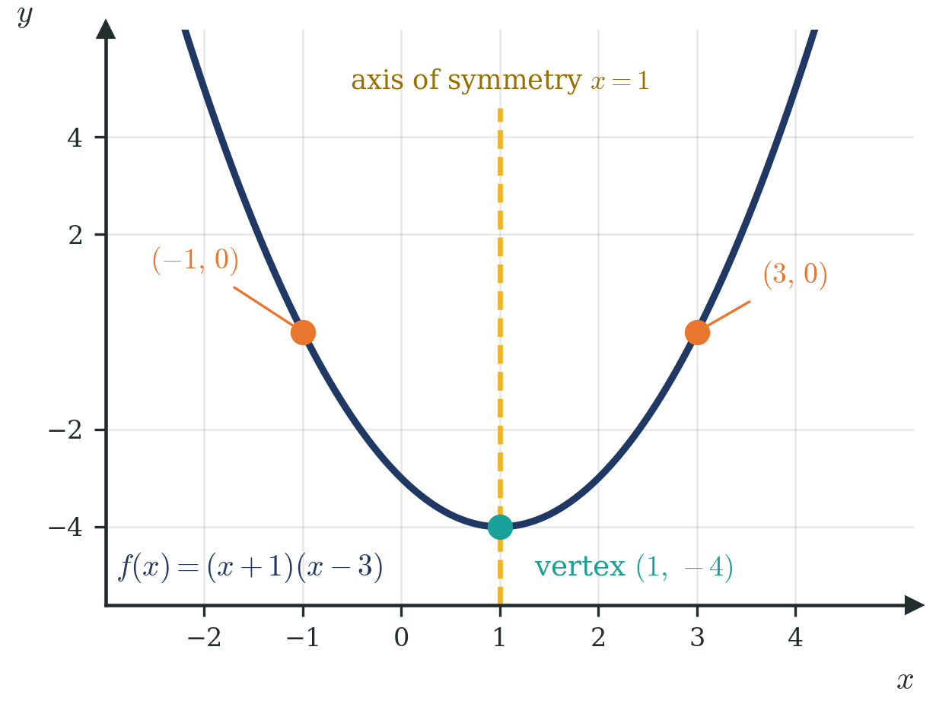
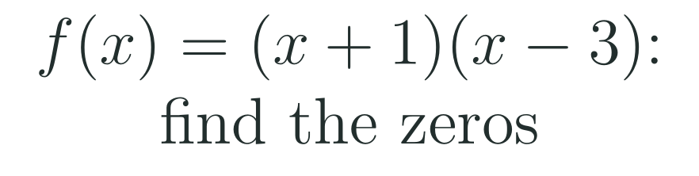
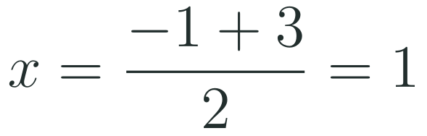

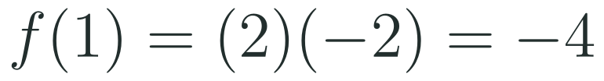

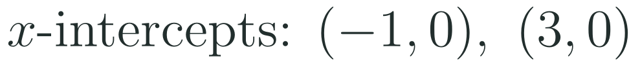
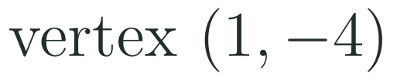
1
2
3
4
5
6
STATION 2 · TARGETED INSTRUCTION · 18 MIN
Factored form shows the zeros
EXAMPLE A
EXAMPLE B
HSA.SSE.A.1.B · HSA.SSE.B.3.A · HSA.APR.B.3 · HSF.IF.C.7 · HSF.IF.C.7.A · HSA.SSE.A.2 · HSF.IF.C.8.A
FAITH, RIGHTEOUSNESS AND WISDOM
Mr Malek Thiab · 6
Notes:
Speaker notes (Targeted Instruction, block 1 of 3):
Worked solutions. Example 1: f(x) = (x+1)(x-3). Set each bracket to 0: x+1 = 0 gives x = -1; x-3 = 0 gives x = 3. The x-intercepts are (-1, 0) and (3, 0). Example 2: the axis of symmetry is halfway between the zeros: (-1 + 3)/2 = 1, so x = 1. Substitute x = 1: f(1) = (1+1)(1-3) = (2)(-2) = -4, so the vertex is (1, -4). Extra check on the figure: the y-intercept is f(0) = (1)(-3) = -3, and expanded f(x) = x^2 - 2x - 3, the same parabola as in standard form. Point to the figure: the two orange points are the zeros, the teal point is the vertex, the gold dashed line is the axis. Verbal misconceptions: (1) the zero of (x+1) is -1, not +1 - the zero is the value that makes the bracket 0; (2) zeros are x-values, the x-intercepts are the points (-1, 0) and (3, 0); (3) the vertex y-value comes from substituting the axis value, not from averaging the zeros' y-values; (4) a changes the stretch and direction but never moves the zeros. Adaptive routing: if >30% give 1 and -3 (wrong signs) for Example 1, repeat Example 1 with f(x) = (x-2)(x+5) before moving on; if >30% miss Q1 of the Mastery Gate come back to this slide (slide 6 / block 1).

Slide 7



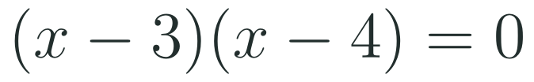
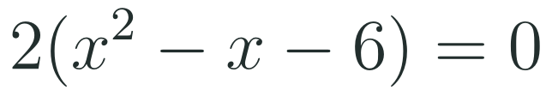

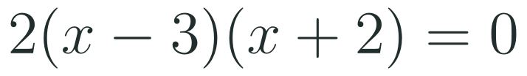
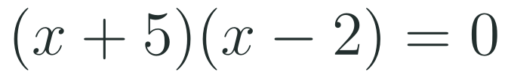



1
2
3
4
5
6
STATION 2 · TARGETED INSTRUCTION · 18 MIN
Solve by factoring
EXAMPLE A
EXAMPLE B
EXAMPLE C
HSA.SSE.A.1.B · HSA.SSE.B.3.A · HSA.APR.B.3 · HSF.IF.C.7 · HSF.IF.C.7.A · HSA.SSE.A.2 · HSF.IF.C.8.A
FAITH, RIGHTEOUSNESS AND WISDOM
Mr Malek Thiab · 7
Notes:
Speaker notes (Targeted Instruction, block 2 of 3):
Worked solutions. Example 1: x^2 - 7x + 12 = 0. Need two numbers with product 12 and sum -7: -3 and -4. So (x-3)(x-4) = 0, hence x = 3 or x = 4. Check: 9 - 21 + 12 = 0 and 16 - 28 + 12 = 0. Example 2: 2x^2 - 2x - 12 = 0. Take out the common factor 2: 2(x^2 - x - 6) = 0. Product -6, sum -1: -3 and 2, so 2(x-3)(x+2) = 0, giving x = 3 or x = -2. The factor 2 never equals 0, so it gives no solution. Check: 2(9) - 6 - 12 = 0 and 2(4) + 4 - 12 = 0. Example 3: x^2 + 3x = 10 is not yet equal to 0. Subtract 10: x^2 + 3x - 10 = 0. Product -10, sum 3: 5 and -2, so (x+5)(x-2) = 0, giving x = -5 or x = 2. Check: 25 - 15 - 10 = 0 and 4 + 6 - 10 = 0. Verbal misconceptions: (1) get 0 on one side first - for (x-2)(x-3) = 6 you can NOT write x-2 = 6; (2) do not drop the second solution; (3) a common factor is not a solution, so do not write x = 2; (4) sign of the bracket versus sign of the solution: (x+5) gives x = -5. Adaptive routing: if >30% miss Q2 of the Mastery Gate come back to this slide (slide 7 / block 2); if >30% write x-2 = 6 style answers, show Example 3 again and use the smart-production non-example on slide 12.

Slide 8
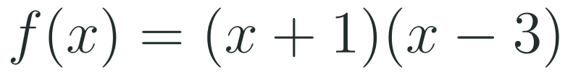
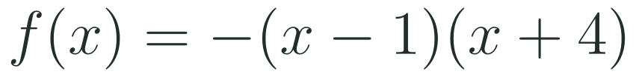
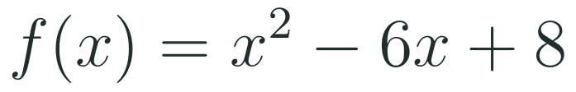


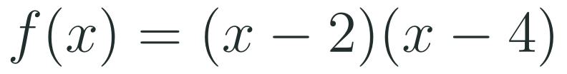



1
2
3
4
5
6
STATION 2 · TARGETED INSTRUCTION · 18 MIN
Positive and negative intervals
EXAMPLE A
EXAMPLE B
EXAMPLE C
HSA.SSE.A.1.B · HSA.SSE.B.3.A · HSA.APR.B.3 · HSF.IF.C.7 · HSF.IF.C.7.A · HSA.SSE.A.2 · HSF.IF.C.8.A
FAITH, RIGHTEOUSNESS AND WISDOM
Mr Malek Thiab · 8
Notes:
Speaker notes (Targeted Instruction, block 3 of 3):
Worked solutions. Example 1: f(x) = (x+1)(x-3), zeros -1 and 3 give three intervals. f(0) = -3 < 0, so f is negative for -1 < x < 3; f(-2) = (-1)(-5) = 5 > 0 and f(4) = (5)(1) = 5 > 0, so f is positive for x < -1 or x > 3. Example 2: f(x) = -(x-1)(x+4), zeros 1 and -4. f(0) = -(-1)(4) = 4 > 0, so f is positive for -4 < x < 1; f(-5) = -(-6)(-1) = -6 < 0 and f(2) = -(1)(6) = -6 < 0, so f is negative for x < -4 or x > 1. The leading coefficient is negative, so the parabola opens down and the pattern flips. Example 3: x^2 - 6x + 8 = (x-2)(x-4), zeros 2 and 4. f(3) = 9 - 18 + 8 = -1 < 0, so f is negative for 2 < x < 4 and positive for x < 2 or x > 4. Verbal misconceptions: (1) positive and negative describe the OUTPUT f(x), not x; (2) the zeros themselves are neither positive nor negative, so use open intervals with strict inequalities; (3) the two outside intervals are joined with 'or', never 'and'; (4) a negative a flips the pattern. Adaptive routing: if >30% miss Q3 of the Mastery Gate come back to this slide (slide 8 / block 3); if >30% flip the Example 2 answer, redo it by testing one point in each interval before looking at the sign of a.

Slide 9

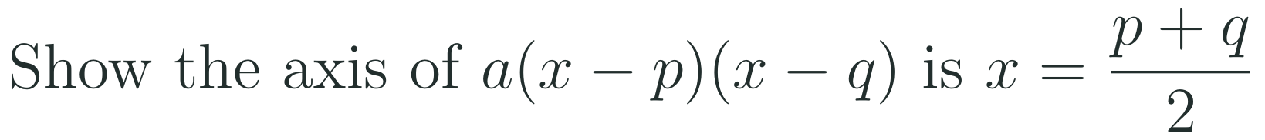
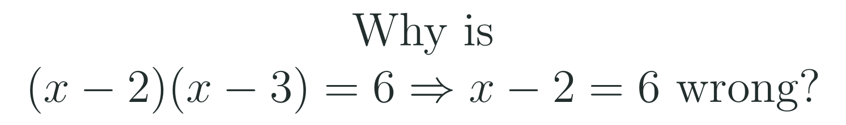
1
2
3
4
5
6
STATION 3 · PRACTICE · 12 MIN
Give it a go: Practice, Apply, Investigate
PRACTICE
APPLY
INVESTIGATE
Secure the method
Use it in context
Find out why
Done when: each solution is checked by substitution and the zeros are also written as x-intercepts.
Done when: your function is checked by substituting a point and the interval is written with strict inequality signs.
Done when: your argument uses the zero-product property or the symmetry of the zeros, not just a computed answer.
HSA.SSE.A.1.B · HSA.SSE.B.3.A · HSA.APR.B.3 · HSF.IF.C.7 · HSF.IF.C.7.A · HSA.SSE.A.2 · HSF.IF.C.8.A
FAITH, RIGHTEOUSNESS AND WISDOM
Mr Malek Thiab · 9
Notes:
Speaker notes (Practice, 12 min; tierless differentiation: students choose the starting column and may move across):
Answers. Practice 1: x^2 + 8x + 15 = (x+3)(x+5) = 0, so x = -3 or x = -5; check 9 - 24 + 15 = 0 and 25 - 40 + 15 = 0. Practice 2: set x+3 = 0 and x-2 = 0, zeros -3 and 2, x-intercepts (-3, 0) and (2, 0). Apply 1: f(x) = a(x+2)(x-4); f(0) = a(2)(-4) = -8a = -16, so a = 2 and f(x) = 2(x+2)(x-4); check f(-2) = 0 and f(4) = 0. Apply 2: x^2 - x - 6 = (x-3)(x+2), zeros -2 and 3, a = 1 > 0 so negative for -2 < x < 3 (check f(0) = -6). Investigate 1: the zeros p and q are the same distance from the axis (symmetry), so the axis is their midpoint (p+q)/2. Investigate 2: the product equals 6, not 0, so the zero-product property does not apply; expanding gives x^2 - 5x = 0, so x = 0 or x = 5 (check (0-2)(0-3) = 6 and (5-2)(5-3) = 6). Verbal misconceptions: students choose the route that feels comfortable - remind them they may switch at any time; the factor pair with the right product but wrong sum; reading the zero of (x+3) as 3. Adaptive routing: if >30% of Practice students miss item 1, route them to slide 7 / block 2 Example 1 with a partner; if >30% of Apply students cannot find a, return to slide 6 / block 1 and substitute the point; if Investigate stalls, point to the figure on slide 6.

Slide 10
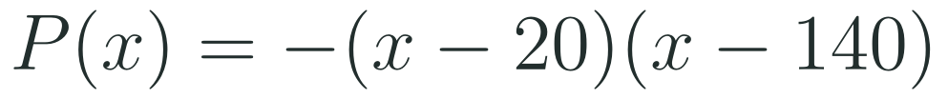
1
2
3
4
5
6
STATION 4 · PRODUCTION · 12 MIN
Production: the Red Sea dive-tour profit
THE MODEL
DONE WHEN
A Red Sea tourism operator off the Jeddah coast models its daily profit from a dive-boat tour as a quadratic function of the ticket price, in the spirit of Vision 2030 tourism growth. All numbers are model values invented for this lesson, not real company data.
Both zeros are found by setting each bracket equal to 0 and are labelled with SAR.
The profit interval is written with strict inequalities and explained in a sentence.
The best price comes from the axis of symmetry and is checked by substitution.
Every answer has units (SAR) and a sentence about what it means for the operator.
Find the two break-even ticket prices (the zeros) and write them as x-intercepts.
Find the prices where the tour makes a profit and the price that gives the largest profit.
Find the profit at a ticket price of 100 SAR and compare it with the largest profit.
Hint for solving: the best price is halfway between the break-even prices; substitute it into the function to get the largest profit.
HSA.SSE.A.1.B · HSA.SSE.B.3.A · HSA.APR.B.3 · HSF.IF.C.7 · HSF.IF.C.7.A · HSA.SSE.A.2 · HSF.IF.C.8.A
FAITH, RIGHTEOUSNESS AND WISDOM
Mr Malek Thiab · 10
Notes:
Speaker notes (Production, 12 min):
Model values only. Task 1: set -(x-20)(x-140) = 0, so x = 20 or x = 140; the x-intercepts are (20, 0) and (140, 0): at 20 SAR and 140 SAR the profit is exactly 0 (break-even). Task 2: a = -1 < 0, so the parabola opens down and P > 0 between the zeros: profit for 20 < x < 140 (strict inequalities; at 20 and 140 the profit is 0). The axis is x = (20 + 140)/2 = 80, so the best price is 80 SAR. Largest profit P(80) = -(60)(-60) = 3600 SAR. Task 3: P(100) = -(80)(-40) = 3200 SAR, which is 400 SAR less than the largest profit 3600 SAR (100 is 20 SAR above the axis value 80). Extra: P(50) = 2700 SAR and P(160) = -2800 SAR (a loss). Verbal misconceptions: students forget the minus sign in front of the factors and get a minimum instead of a maximum; they read the zeros of -(x-20) as -20; they give the maximum value as x = 80 instead of 3600 SAR - the maximum is the output, 80 is the price. Adaptive routing: if >30% cannot find the best price, return to slide 6 / block 1 (axis halfway between zeros); if >30% write the profit interval with 'and', return to slide 8 / block 3.

Slide 11

1
2
3
4
5
6
STATION 5 · MASTERY GATE · 6 MIN
Mastery Gate: three questions to pass
1
2
3
Pass mark
3 of 3 correct unlocks Station 6. Fewer than that: return to the slide for the question you missed, redo it, then re-take the gate.
HSA.SSE.A.1.B · HSA.SSE.B.3.A · HSA.APR.B.3 · HSF.IF.C.7 · HSF.IF.C.7.A · HSA.SSE.A.2 · HSF.IF.C.8.A
FAITH, RIGHTEOUSNESS AND WISDOM
Mr Malek Thiab · 11
Notes:
Speaker notes (Mastery Gate, 6 min, no calculator):
Answers. Q1: zeros x = -6 and x = 2; axis x = (-6 + 2)/2 = -2. Q2: x^2 - x - 12 = (x-4)(x+3) = 0, so x = 4 or x = -3 (check 16 - 4 - 12 = 0 and 9 + 3 - 12 = 0). Q3: zeros -2 and 5; a = 1 > 0 so f is negative between them: -2 < x < 5 (check f(0) = (2)(-5) = -10 < 0). Traps to expect: Q1 zeros 6 and -2 (sign of bracket misread) or axis -4 (sum instead of half the sum); Q2 x = -4 or x = 3 (signs swapped) or x = 12; Q3 x < -2 or x > 5 (outside interval) or the closed interval with 'less than or equal to'. Adaptive routing: Q1 missed -> slide 6 / block 1; Q2 missed -> slide 7 / block 2; Q3 missed -> slide 8 / block 3. Score live, route privately through the LMS, and never announce the clinic list to the class. If >30% miss any one question, reteach that block with a new example at the start of the next lesson.

Slide 12


1
2
3
4
5
6
STATION 6 · SMART PRODUCTION · 6 MIN
Smart Production: make one, then check it
CREATE
TIME TO CHECK
Write one quadratic function in factored form with two integer zeros.
Write the zeros, the axis, the vertex and the intervals where it is positive and negative on the back.
Swap with a partner, solve theirs and check it by substituting a point.
Exit ticket: write your answer on a sticky note and place it on the door.
Done when: your solution is complete and correct, and your partner agrees with every step.
Next lesson: 2-4 Overview of Complex Numbers.
HSA.SSE.A.1.B · HSA.SSE.B.3.A · HSA.APR.B.3 · HSF.IF.C.7 · HSF.IF.C.7.A · HSA.SSE.A.2 · HSF.IF.C.8.A
FAITH, RIGHTEOUSNESS AND WISDOM
Mr Malek Thiab · 12
Notes:
Speaker notes (Smart Production, 6 min):
Exit ticket solutions. Q1: x^2 - 6x + 5 = (x-1)(x-5) = 0, so x = 1 or x = 5 (check 1 - 6 + 5 = 0 and 25 - 30 + 5 = 0). Q2: a = 1 > 0, so the expression is negative between the zeros: 1 < x < 5 (check f(3) = 9 - 18 + 5 = -4 < 0). Non-example for the creation task: solving (x-2)(x-3) = 6 as x = 8 or x = 9 is wrong because the product is 6, not 0; expanding gives x^2 - 5x = 0, so x = 0 or x = 5, and (0-2)(0-3) = 6, (5-2)(5-3) = 6. Verbal misconceptions: students answer x = -1 and x = -5 (signs of the brackets copied as solutions); they say 'between 1 and 5' without strict inequality; they write the interval as 1 < x < 5 only for an upward parabola and forget to check a. Adaptive routing: if >30% miss exit Q1, start the next lesson with a 10-minute factoring clinic using slide 7 / block 2; if >30% miss exit Q2, reteach intervals using slide 8 / block 3. If time is short, cut Smart Production and carry it over, never the Mastery Gate.

Slide 13
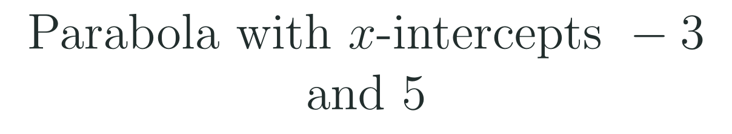
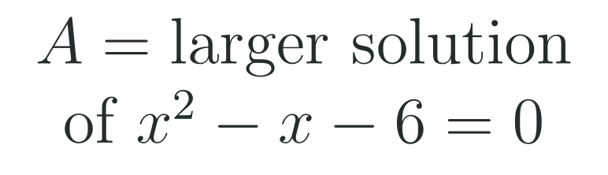
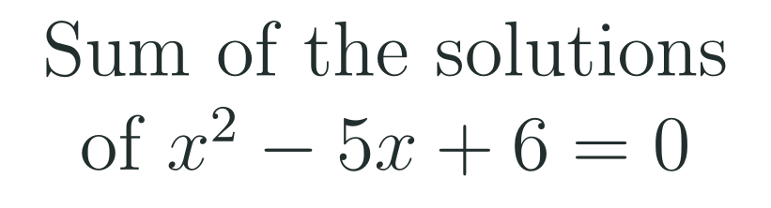

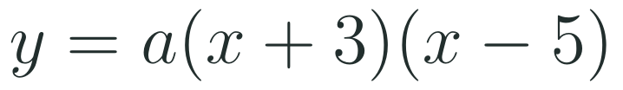
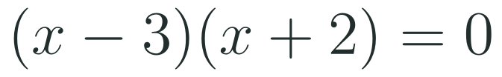
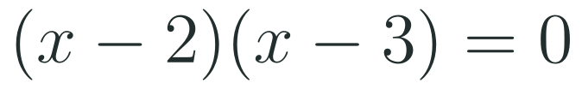
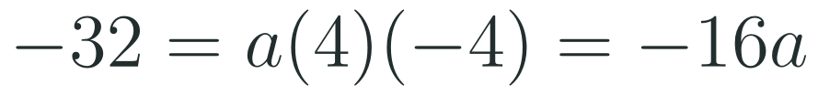




Exam connections
SAT
GAT
SAAT
STEPS
STEPS
STEPS
1
1
1
2
2
2
3
3
3
HSA.SSE.A.1.B · HSA.SSE.B.3.A · HSA.APR.B.3 · HSF.IF.C.7 · HSF.IF.C.7.A · HSA.SSE.A.2 · HSF.IF.C.8.A
FAITH, RIGHTEOUSNESS AND WISDOM
Mr Malek Thiab · 13
Notes:
Speaker notes: each exam item is worked in numbered steps.
SAT (grid-in or four options, Advanced Math): y = a(x+3)(x-5); substitute (1, -32): -32 = a(1+3)(1-5) = a(4)(-4) = -16a, so a = 2, and y = 2(x+3)(x-5). Trap: writing y = a(x-3)(x+5) (signs of zeros reversed), which gives the wrong a = 8/3 because a(-2)(6) = -32, or forgetting a and answering y = (x+3)(x-5), which passes through (1, -16), not (1, -32). GAT/Qudurat (quantitative comparison: A greater, B greater, equal, cannot be determined): x^2 - x - 6 = (x-3)(x+2) = 0, so x = 3 or x = -2; the larger is 3, so A = B = 3, answer: equal. Trap: choosing -2 as the larger, taking x = 6 from the constant term, or answering 'cannot be determined' because there are two solutions. SAAT/Tahsili (four options, no calculator): x^2 - 5x + 6 = (x-2)(x-3) = 0, solutions 2 and 3, sum 5. Trap: the product 6 (the constant term), the sum with the sign of b (-5), or the difference 1. Verbal misconceptions: the single most tested idea is to set the factored expression equal to 0 and read the zeros, watching the sign inside each bracket. Adaptive routing: if >30% miss the SAT item, go to slide 6 / block 1 (writing a function from zeros); if >30% miss the GAT item, go to slide 7 / block 2; if >30% miss the SAAT item, use Vieta-style checking: the sum of the solutions equals -b/a.

Slide 14
Journey complete
Targeted Instruction
Production
Smart Production
✓
✓
✓
✓
✓
✓
Diagnose
Practice
Mastery Gate
Factor, set each bracket to 0, and read the zeros, the axis and the intervals where a quadratic is positive or negative.
FAITH, RIGHTEOUSNESS AND WISDOM
Notes:
Speaker notes: Every station is checked off. Recap in one sentence: Factor, set each bracket to 0, and read the zeros, the axis and the intervals where a quadratic is positive or negative. Collect the Time to Check responses. Next lesson: 2-4 Overview of Complex Numbers.

